Slide 1


CONVERSATIONAL AI
Building conversation AI using Azure Bot & LUIS
Nagaraj Sengodan, HCL Technologies
Nitin Raj Soundararajan, Cognizant Worldwide Limited

Slide 2


Who are we?
NAGARAJ SENGODAN
NITIN RAJ SOUNDARARAJAN
Senior Manager – Data and Analytics, HCL Technologies
Senior Consultant – Data, AI and Analytics, Cognizant Worldwide Limited

Slide 3
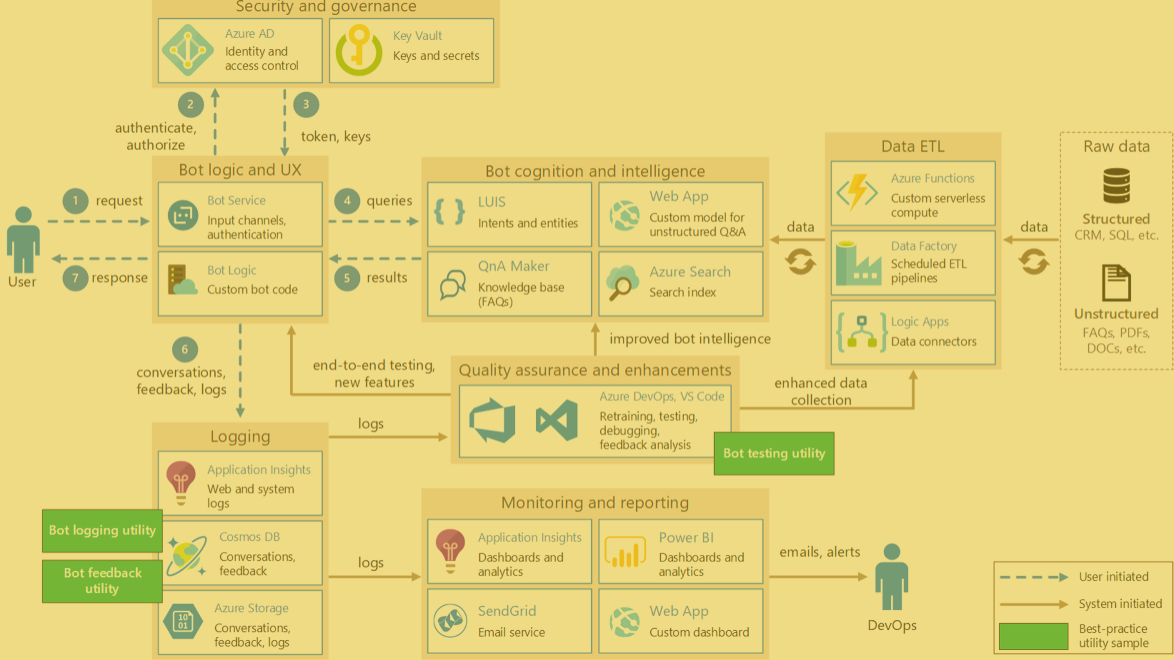
Topics to Cover
What is Conversational AI
BOT Framework
LUIS
Building a BOT
Additional Features
Let's Talk

Slide 4



















Conversational AI
Channels
Knowledge
Sources
General Knowledge
Manuals (PDF)
A new user interface paradigm
Exposes software services through conversational interface
In apps, browser and on IoT devices
Pro-active capabilities (Virtual Assistant etc.)
AI Capabilities
Data Sources
User
Input
Azure Bot
Services
Conversation Skills (Customisable)
Speech
Virtual Assistant
Your Brand
Your Personality
Dialogs
Language Model
Mail
Tasks
Tap
Adaptive Cards
Point of
Interest
Calendar
Type
Speak
Automotive
Hospitality
QnA
Vision
Custom
Language Understanding
Devices
3rd Party
Assistants
APIs
Productivity
1st/3rd Party
Directory

Slide 5
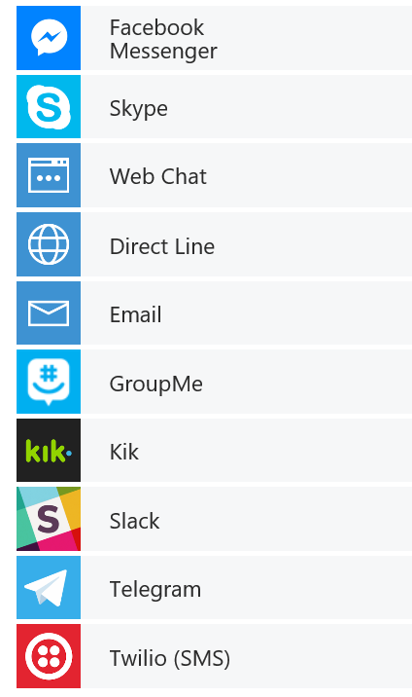


BOT
Framework
channels
Humans
Your Bot – A web app
Tools for building REST Web Sites
Services to enrich
Mechanisms for receive events
Data to debug and analyze
Bot adapts to the user, based on context
Composable and intelligent controls to manage complexity
Any APIs
MS Bot Connector -
Routes Messages, Manages State, Storage etc.
Cognitive APIs

Slide 6
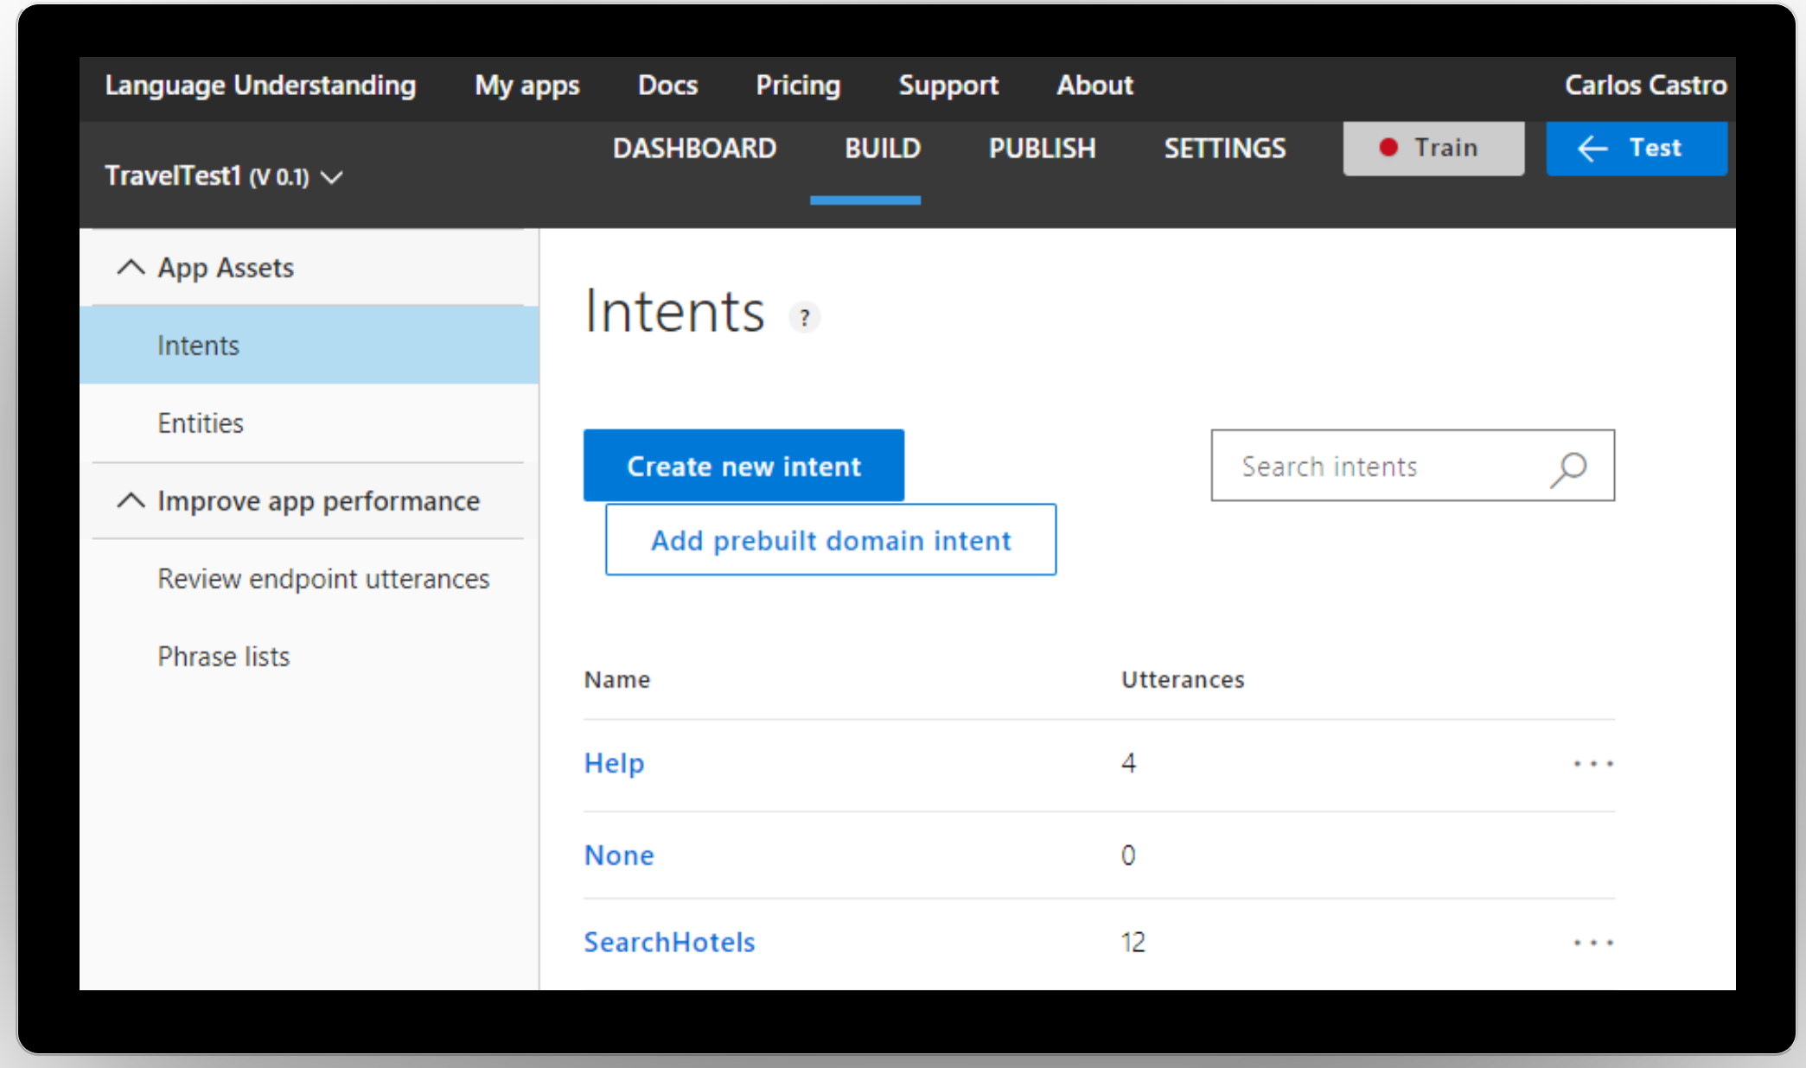
Language Understanding (LUIS)
Quickly build a custom language solution
Add natural language to your apps
Machine learning-based service to build natural language into apps, bots, and IoT devices. Quickly create enterprise-ready, custom models that continuously improve.
Production Staging and Versioning
More Languages (Dutch, Korean, dialects)
Increased Intent and Entity Limits
25 Customizable Prebuilt Domains
Always learning & improving
Enterprise Grade, available worldwide

Slide 7
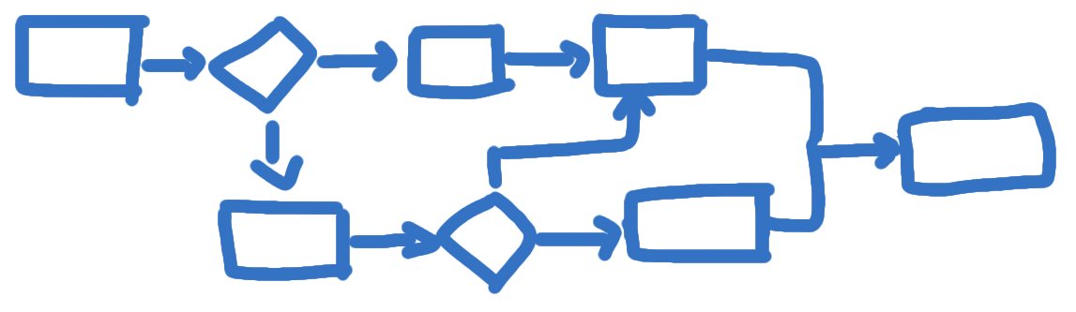
Building a BOT
Bot Builder SDK for .NET with C#
Conversational experiences
Start Simple. Add Complexity. No dead-ends. With help of Azure Bot

Slide 8

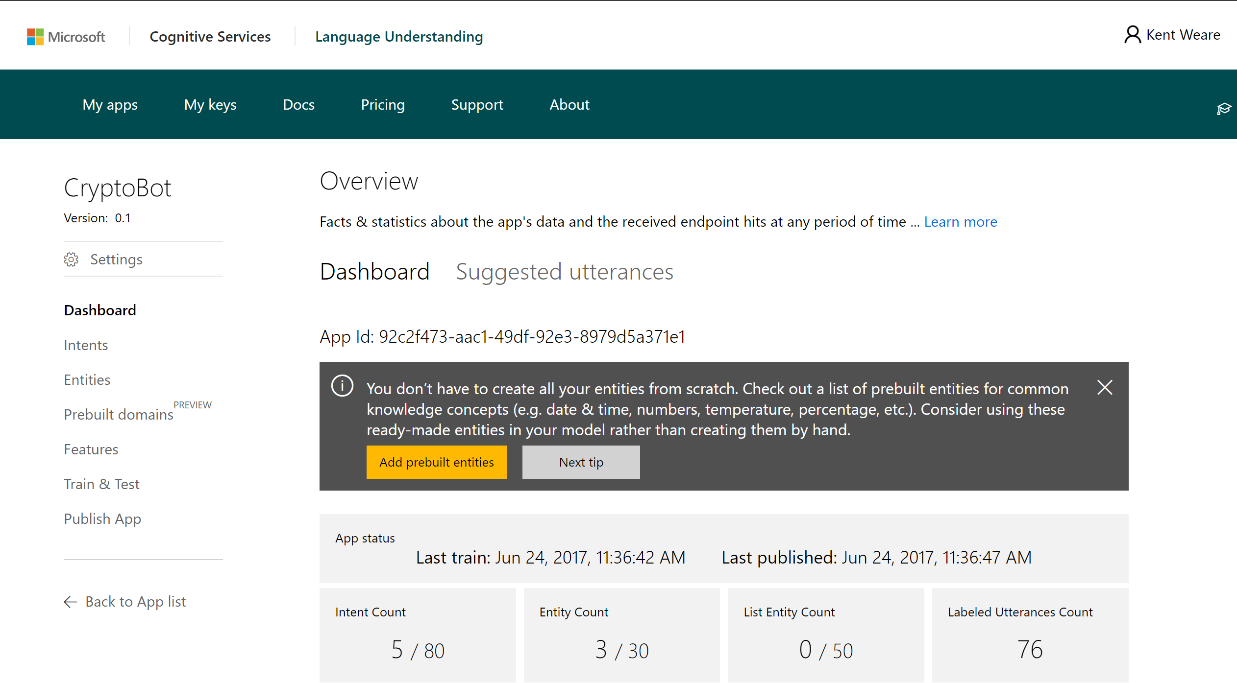
Building a BOT
Define LUIS Intents and Entities

Slide 9
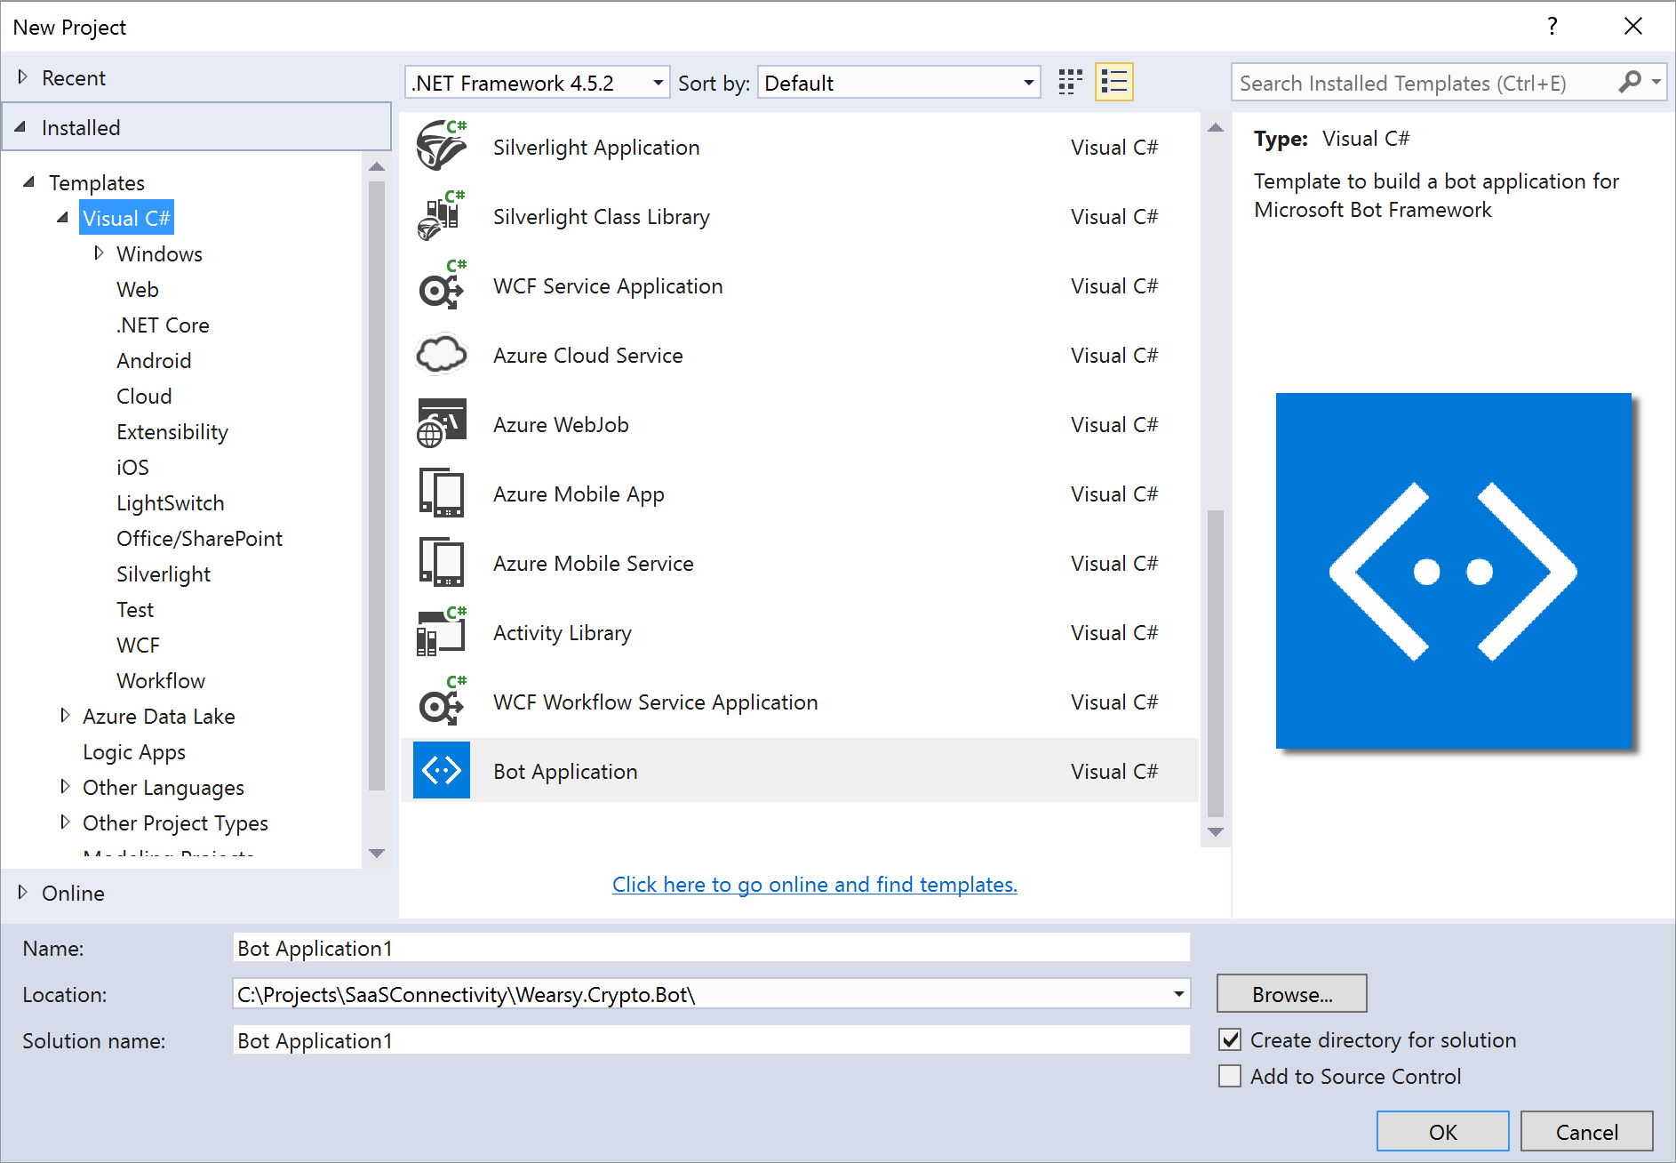
Building a BOT
Define LUIS Intents and Entities
Download Bot Framework Templates and Emulator

Slide 10
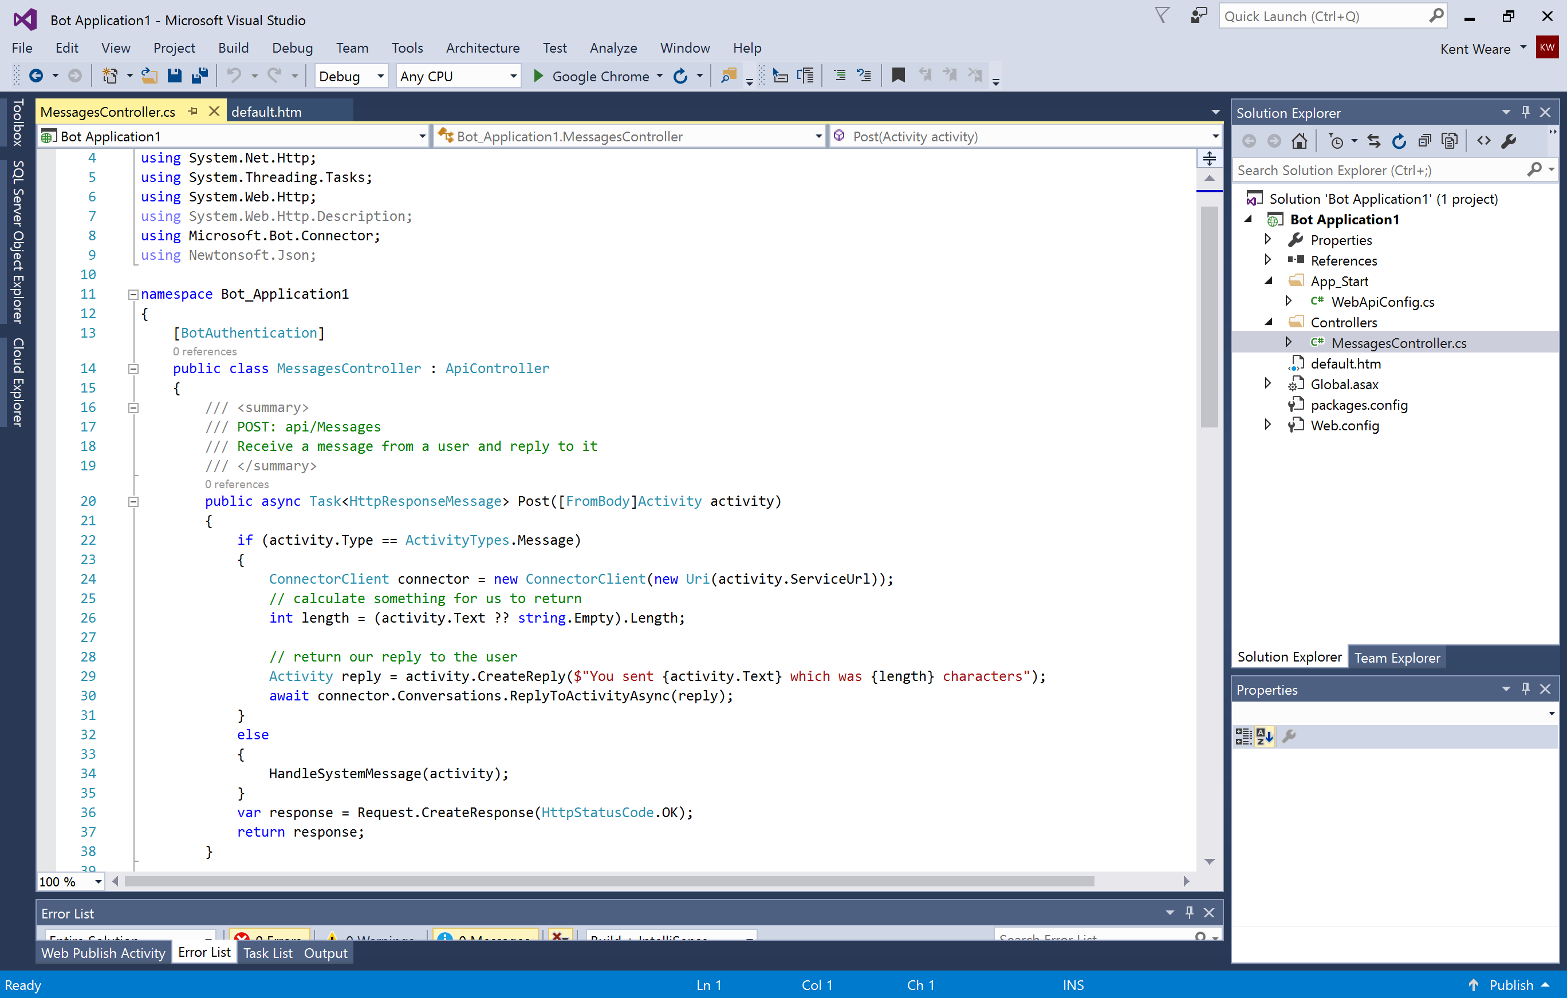
Building a BOT
Define LUIS Intents and Entities
Download Bot Framework Templates and Emulator
Build Controllers, Models and Prompts

Slide 11
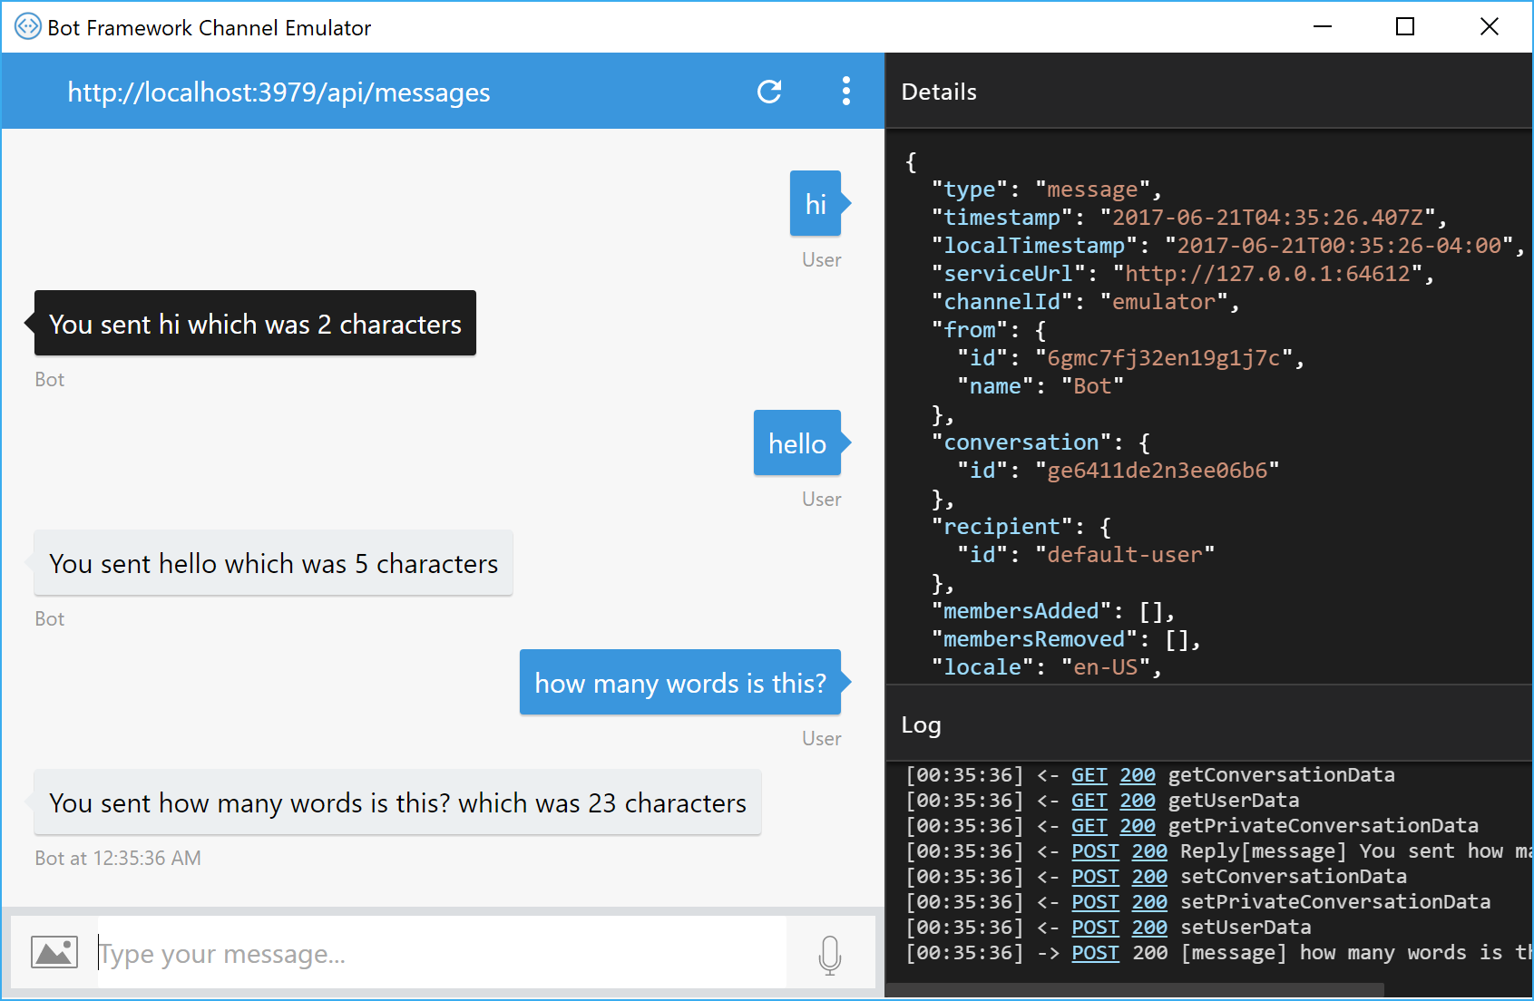
Building a BOT
Define LUIS Intents and Entities
Download Bot Framework Templates and Emulator
Build Controllers, Models and Prompts
Test locally with Emulator

Slide 12
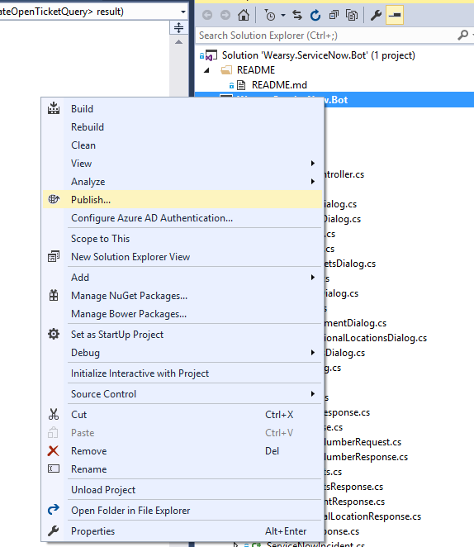
Building a BOT
Define LUIS Intents and Entities
Download Bot Framework Templates and Emulator
Build Controllers, Models and Prompts
Test locally with Emulator
Publish to Azure App Service

Slide 13
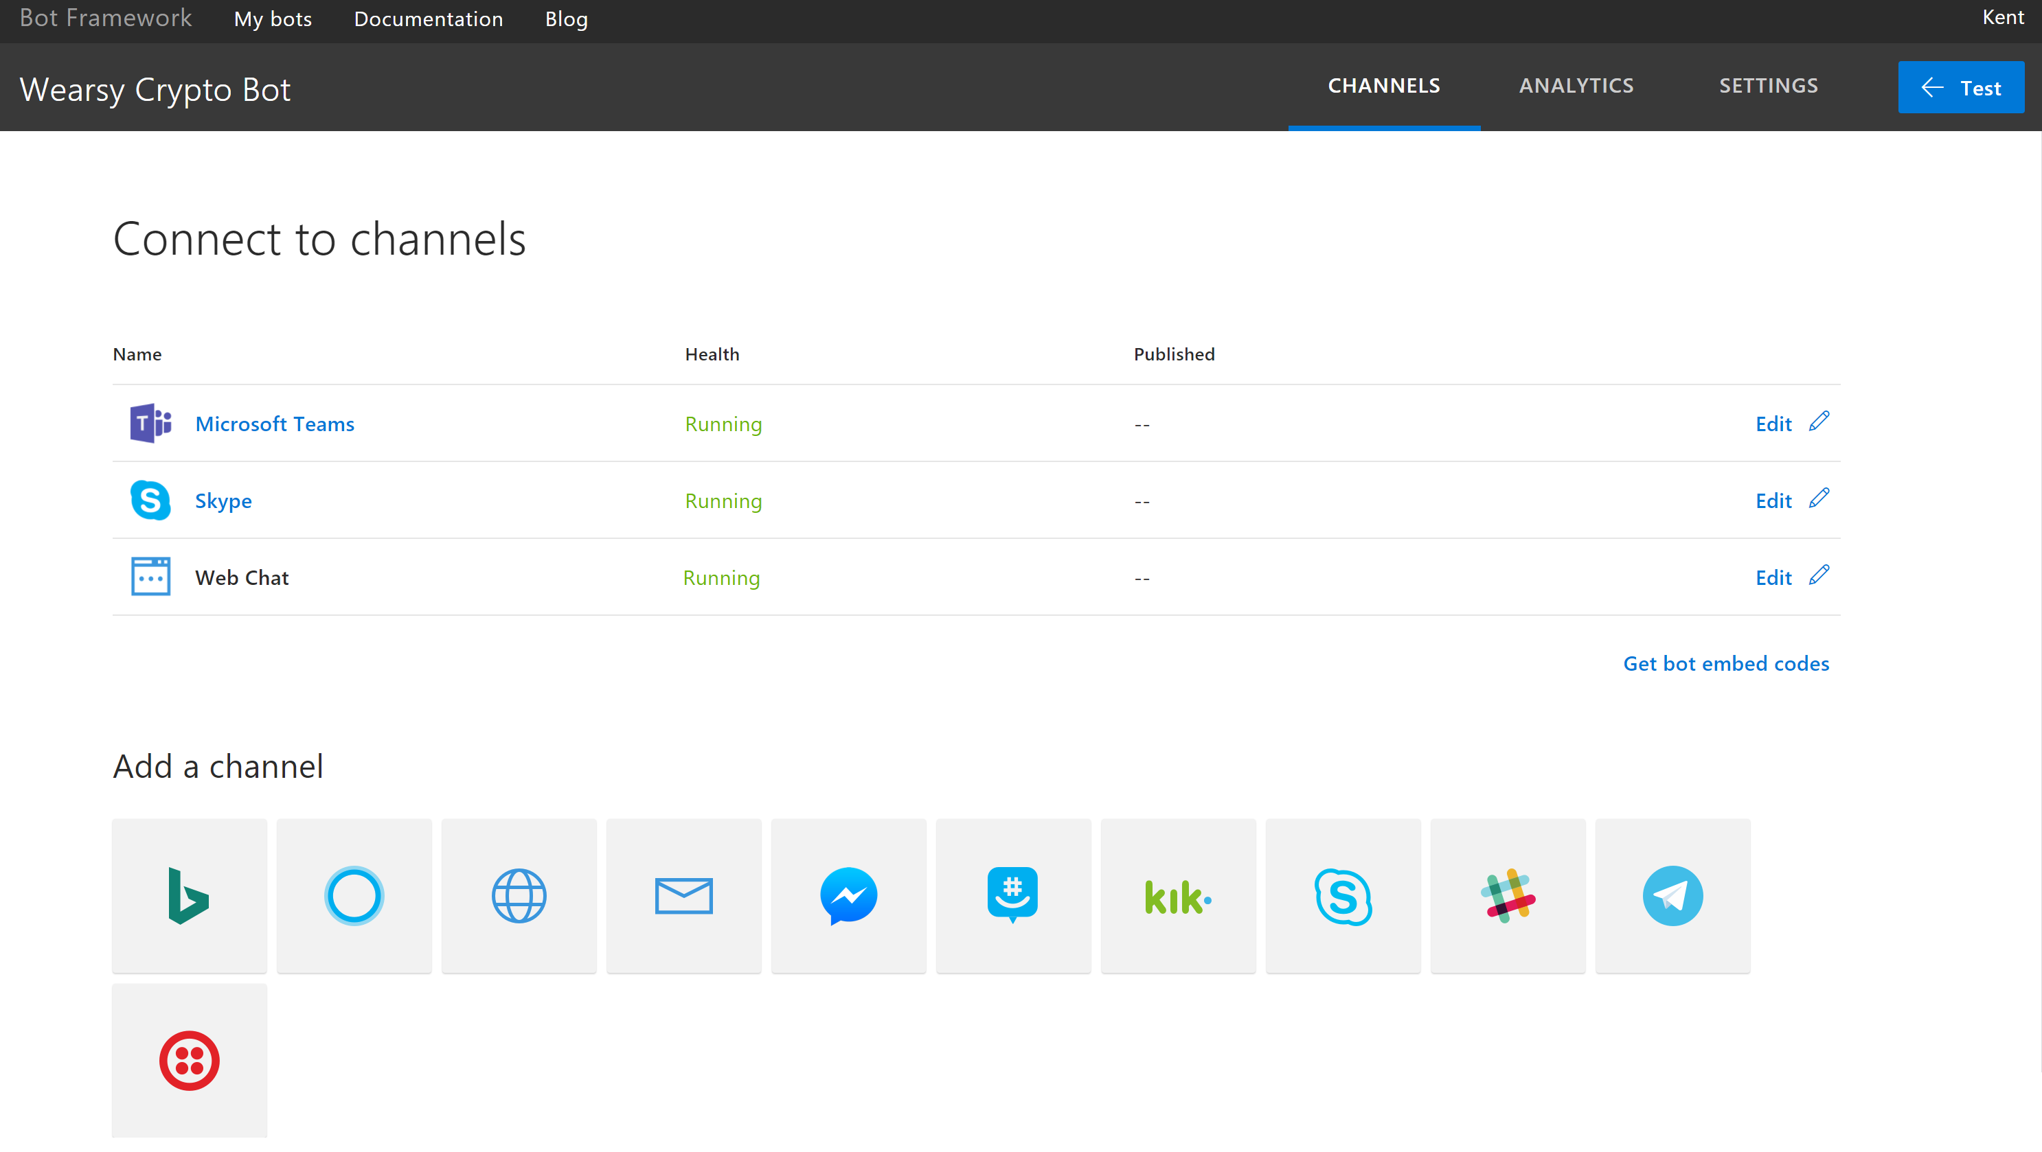
Building a BOT
Define LUIS Intents and Entities
Download Bot Framework Templates and Emulator
Build Controllers, Models and Prompts
Test locally with Emulator
Publish to Azure App Service
Register and Connect Bot

Slide 14
Bot Builder
Platform
Speech Support
Improved Dialog Tools
Debugging Improvements
Channel Inspector
New Channels
Adaptive Cards
Speech Support
Payments
Intelligence
HIGHLIGHTS
Analytics
Bot Controls
Speech Support
Conversational vs Business Logic
SDK Unification
Componentization and Reuse

Slide 15
NAGARAJ SENGODAN
https://in.linkedin.com/in/nagarajsengodan
Let's Talk
Nitin Raj Soundararajan
https://www.linkedin.com/in/nitinrajs/
GITHUB
https://github.com/KRSNagaraj/AI-Robotics-Conference-2019

